Slide 1
Directory implementation
There is the number of algorithms by using which, the directories can be implemented.
However, the selection of an appropriate directory implementation algorithm may significantly affect the performance of the system.
The directory implementation algorithms are classified according to the data structure they are using.
There are mainly two algorithms which are used in these days.

Slide 2
Linear List
In this algorithm, all the files in a directory are maintained as singly linear list. Each file contains the pointers to the data blocks which are assigned to it and the next file in the directory.
Characteristics:
When a new file is created, then the entire list is checked whether the new file name is matching to a existing file name or not. In case, it doesn't exist, the file can be created at the beginning or at the end. Therefore, searching for a unique name is a big concern because traversing the whole list takes time.
The list needs to be traversed in case of every operation (creation, deletion, updating, etc.) on the files therefore the systems become inefficient.

Slide 3
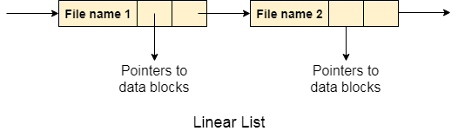

Slide 4
Hash Table
To overcome the drawbacks of singly linked list implementation of directories, there is an alternative approach that is hash table. This approach suggests to use hash table along with the linked lists.
A key-value pair for each file in the directory gets generated and stored in the hash table. The key can be determined by applying the hash function on the file name while the key points to the corresponding file stored in the directory.
Now, searching becomes efficient due to the fact that now, entire list will not be searched on every operating. Only hash table entries are checked using the key and if an entry found then the corresponding file will be fetched using the value.

Slide 5
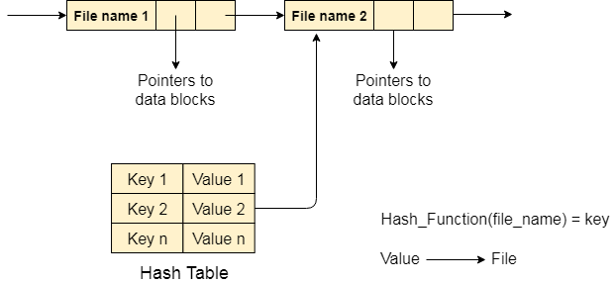

Slide 6
File Allocation Methods
The direct-access nature of secondary storage gives us flexibility in the implementation of files.
In almost every case, many files are stored on the same device.
The main problem is how to allocate space to these files so that storage space is utilized effectively and files can be accessed quickly.
Three major methods of allocating secondary storage space are in wide use:
Contiguous Allocation
Linked Allocation
Indexed Allocation

Slide 7
Contiguous Allocation
In contiguous file allocation, the block is allocated in such a manner that all the allocated blocks in the hard disk are adjacent.
Assuming a file needs 'n' number of blocks in the disk and the file begins with a block at position 'x', the next blocks to be assigned to it will be x+1,x+2,x+3,...,x+n-1 so that they are in a contiguous manner.
Let's understand this diagrammatically.
Example
We have three different types of files that are stored in a contiguous manner on the hard disk.

Slide 8
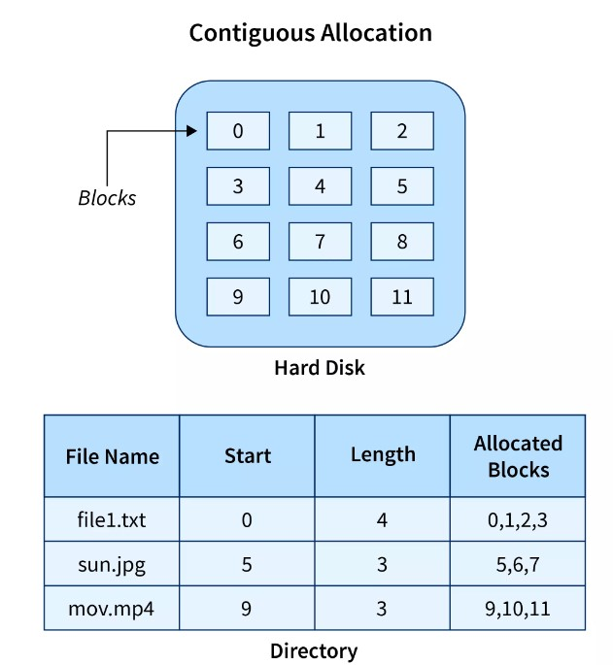

Slide 9
In the above image on the left side, we have a memory diagram where we can see the blocks of memory.
At first, we have a text file named file1.txt which is allocated using contiguous memory allocation, it starts with the memory block 0 and has a length of 4 so it takes the 4 contiguous blocks 0,1,2,3.
Similarly, we have an image file and video file named sun.jpg and mov.mp4 respectively, which you can see in the directory that they are stored in the contiguous blocks. 5,6,7 and 9,10,11 respectively.
Here the directory has the entry of each file where it stores the address of the starting block and the required space in terms of the block of memory.

Slide 10
Advantages
It is very easy to implement.
There is a minimum amount of seek time.
The disk head movement is minimum.
Memory access is faster.
It supports sequential as well as direct access.
Disadvantages
At the time of creation, the file size must be initialized.
As it is pre-initialized, the size cannot increase.
Due to its constrained allocation, it is possible that the disk would fragment internally or externally.

Slide 11
Linked File Allocation
The Linked file allocation overcomes the drawback of contiguous file allocation.
Here the file which we store on the hard disk is stored in a scattered manner according to the space available on the hard disk.
Now, you must be thinking about how the OS remembers that all the scattered blocks belong to the same file.
So as the name linked File Allocation suggests, the pointers are used to point to the next block of the same file, therefore along with the entry of each file each block also stores the pointer to the next block.
Let's understand this better diagrammatically by taking an example.
Example
Here we have one file which is stored using Linked File Allocation.

Slide 12
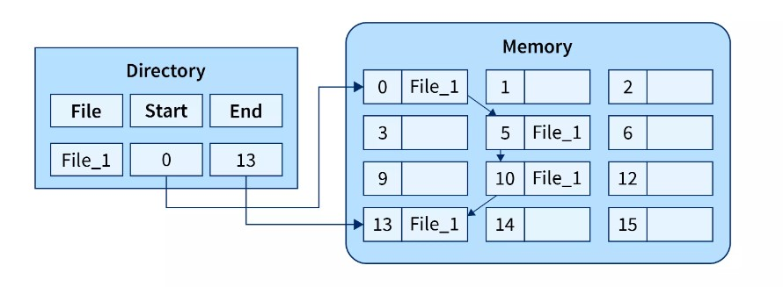

Slide 13
In the above image on the right, we have a memory diagram where we can see memory blocks.
On the left side, we have a directory where we have the information like the address of the first memory block and the last memory block.
In this allocation, the starting block given is 0 and the ending block is 15, therefore the OS searches the empty blocks between 0 and 15 and stores the files in available blocks, but along with that it also stores the pointer to the next block in the present block.
Hence it requires some extra space to store that link.

Slide 14
Advantages
There is no external fragmentation.
The directory entry just needs the address of starting block.
The memory is not needed in contiguous form, it is more flexible than contiguous file allocation.
Disadvantages
It does not support random access or direct access.
If pointers are affected so the disk blocks are also affected.
Extra space is required for pointers in the block.

Slide 15
Indexed File Allocation.
The indexed file allocation is somewhat similar to linked file allocation as indexed file allocation also uses pointers but the difference is here all the pointers are put together into one location which is called index block.
That means we will get all the locations of blocks in one index file.
The blocks and pointers were spread over the memory in the Linked Allocation method, where retrieval was accomplished by visiting each block sequentially.
But here in indexed allocation, it becomes easier with the index block to retrieve.
Let's take an example to explain this better.
Example
As shown in the diagram below block 19 is the index block which contains all the addresses of the file named text1. In order, the first storage block is 9, followed by 16, 1, then 10, and 25. The negative number -1 here denotes the empty index block list as the file text1 is still too small to fill more blocks.

Slide 16
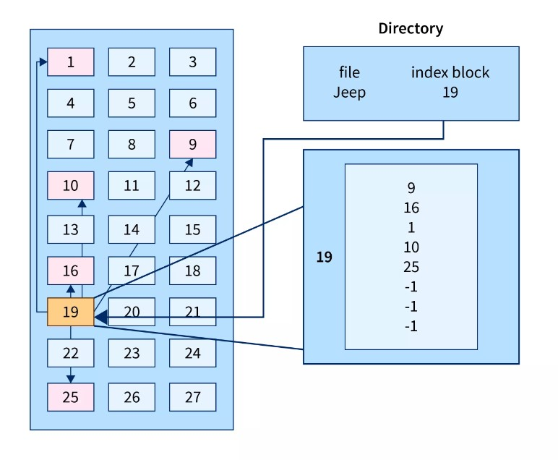

Slide 17
Advantages
It reduces the possibilities of external fragmentation.
Rather than accessing sequentially it has direct access to the block.
Disadvantages
Here more pointer overhead is there.
If we lose the index block we cannot access the complete file.
It becomes heavy for the small files.
It is possible that a single index block cannot keep all the pointers for some large files.

Slide 18
To resolve this issue, we can use the following approaches:
Linked scheme
Multilevel Index
Combined Scheme
1. Linked Scheme
If the file is big then more blocks are required so one index block is insufficient to store all the pointers, therefore to store the pointers two or more index blocks are used where these index boxes are connected using linked file allocation that is each index block stores the pointer to the next index block.

Slide 19
2. Multilevel Index
In this method, the multiple indexes blocks along with the levels of these blocks.
Here, the level 1 block is used for pointing to the level 2 block which points to the blocks occupied by the file.
These index blocks can be extended to three or more levels according to the size of the file.
3. Combined Scheme
In Combined Scheme, a special block is used to store all the information related to the file like name, authority, size, etc.
The special block is called inode(information-node).
Some space of this special block is used to store the information related to the field as mentioned above and the remaining space is used to store the addresses of blocks that contain the actual file.

